Slide 1


SAP Full-Stack Developer training
ABAP on HANA, UI5 & Fiori, Analytics with OData
Anubhav Oberoy
Day – 16

Slide 2

Agenda – Day 16
Hierarchy CDS Programming with Tree Table
New Hierarchy
Classical Hierarchy
Implementation of End to End Hierarchy Scenario of Employee Manager Hierarchy
Describing Functional Information of Hierarchy
Create Fiori App with annotation File on Top of CDS
--Break--
Describing Details about Idoc
Creating End to End S/4 HANA Scenario for OVP ( Analytics )
Create your OVP ( Overview page ) UX Elements show Analytical dashboard

Slide 3
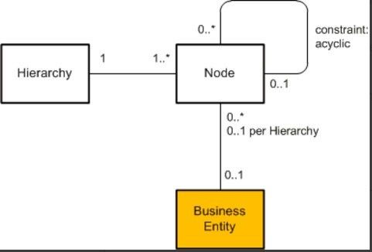
CDS Hierarchy
The CDS view provides a list of hierarchies which is known the hierarchy directory for this node view. Every single node belongs to exactly one hierarchy, which can identified by one or multiple key fields of the node view.
A hierarchy can have multiple root nodes.
Hierarchies allows to traverse data faster
They clearly explain the inter-relation between multiple object
Very helpful determining the parent child relationship

Slide 4
Types of Hierarchy
There are Two types of Hierarchy
Creating Using Annotations
Creating by syntax
CDS Hierarchy
New Hierarchy
Classical Hierarchy

Slide 5

End to End Hierarchy Scenario

Slide 6
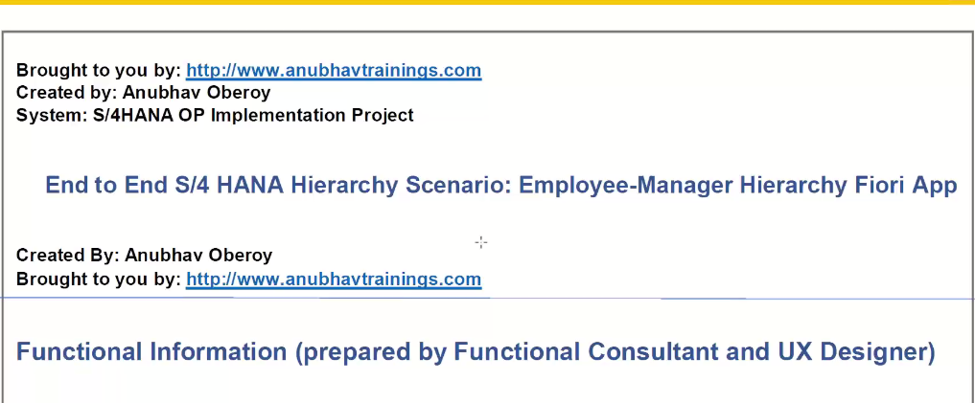
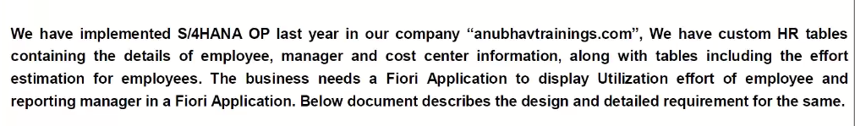
Elaborating Scenario

Slide 7
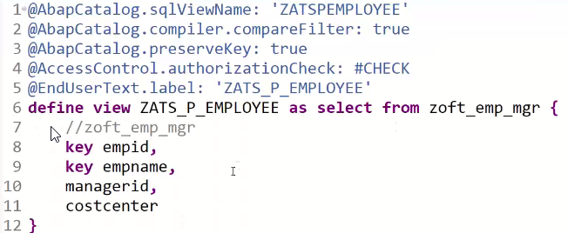
Creating Resource CDS

Slide 8
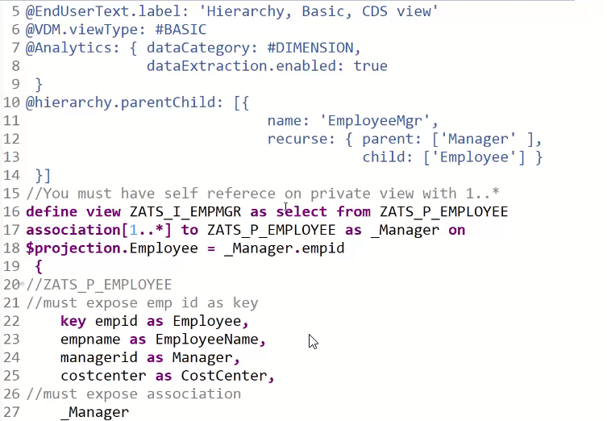
Creating Basic CDS View

Slide 9
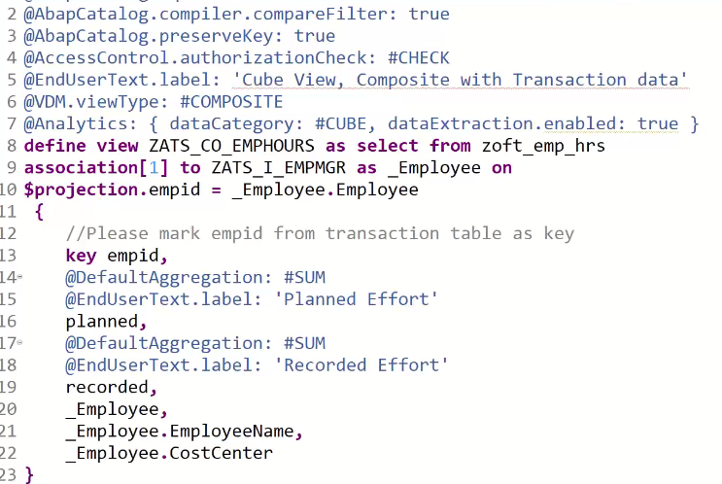
Composite CDS View

Slide 10
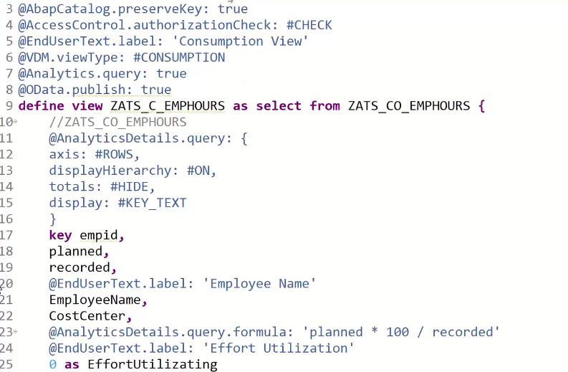
Consumption CDS View

Slide 11
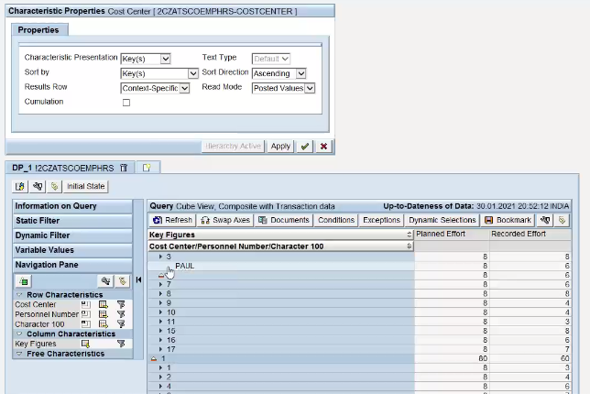
Check Hierarchy

Slide 12
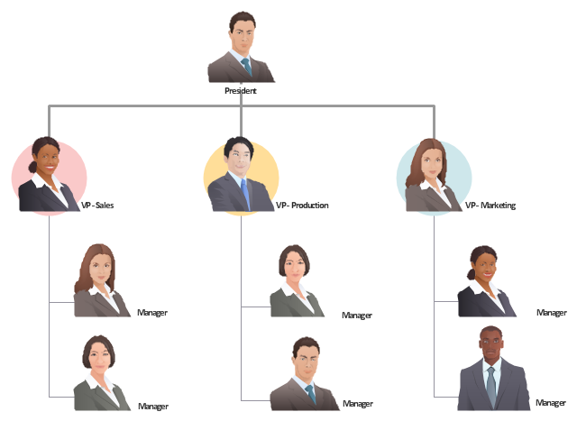
Exercise
CDS Hierarchy Scenario

Slide 13
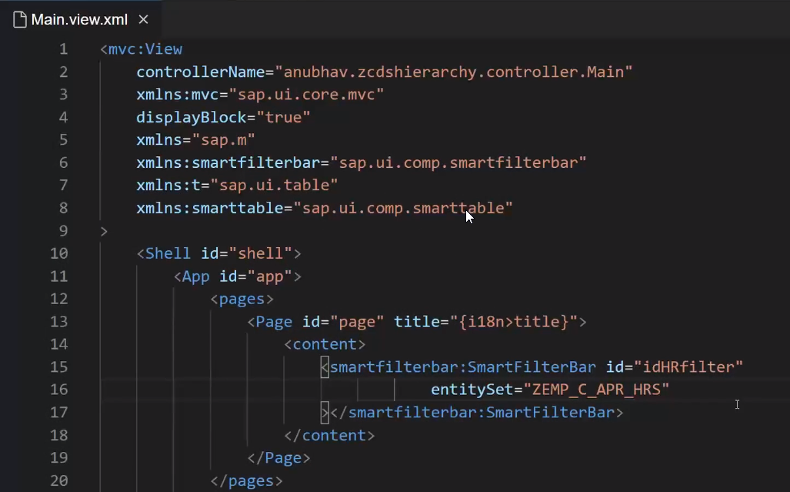
Creating Fiori app on top of CDS

Slide 14

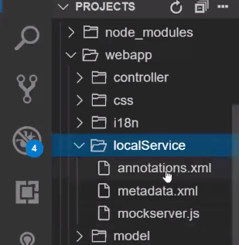
Creating Annotation File
Annotataion file

Slide 15
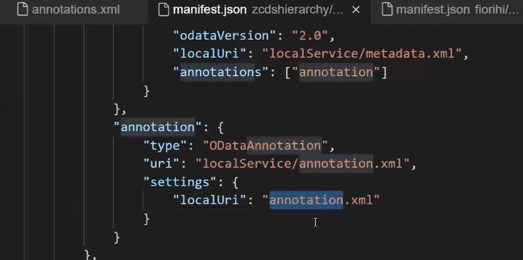
Linking of Annotation File
Link annotation file use this code in Manifest.json

Slide 16
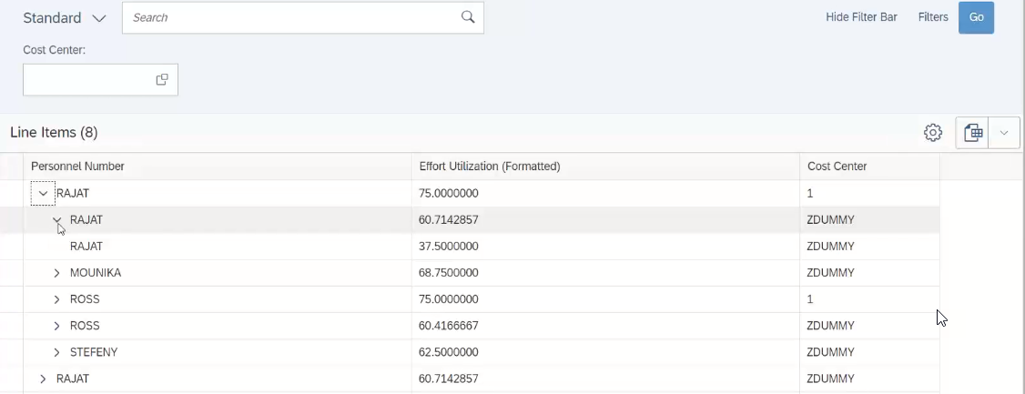
Result Employee Manager Hierarchy
Notes:
The sole purpose of an R/3 system is to provide a suite of tightly integrated, large-scale business applications. R/3 comes prepackaged with the core business applications needed by most large corporations. These applications coexist in one homogenous environment. They are designed from the ground up to run using a single database and one (very large) set of tables.
Presentation: It is usually installed on a user's workstation. When started, the presentation server displays the R/3 menus within a window. This window is commonly known as the SAPGUI, or the user interface (or simply, the interface).
Basis : Basis is like an operating system for R/3. It sits between the ABAP/4 code and the computer's operating system. SAP likes to call it middleware because it sits in the middle, between ABAP/4 and the operating system. ABAP/4 cannot run directly on an operating system. It requires a set of programs (collectively called Basis) to load, interpret, and buffer its input and output. Basis provides the runtime environment for ABAP/4 programs.
Database: The database server is a set of executables that accept database requests from the application server. These requests are passed on to the RDBMS (Relation Database Management System). The RDBMS sends the data back to the database server, which then passes the information back to the application server. The application server in turn passes that information to your ABAP/4 program.

Slide 17

When to go Free style v/s Fiori Element

Slide 18

Break

Slide 19
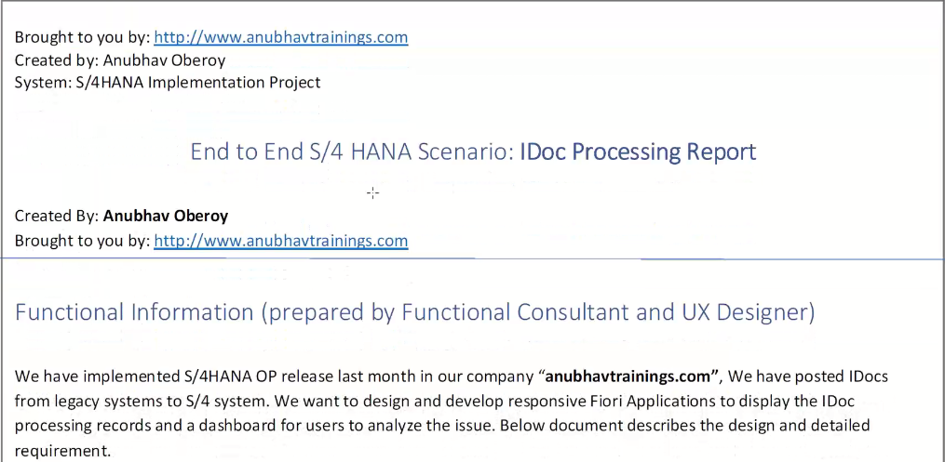
End to End Idoc Reporting Scenario
Idoc, short for Intermediate Document, is a SAP document format for business transaction data transfers. Non SAP-systems can use Idoc as the standard interface (computing) for data transfer. Idoc is similar to XML in purpose, but differs in syntax.

Slide 20
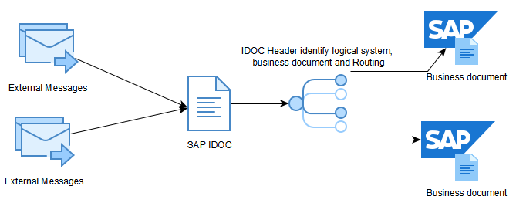
Concept of Idoc

Slide 21
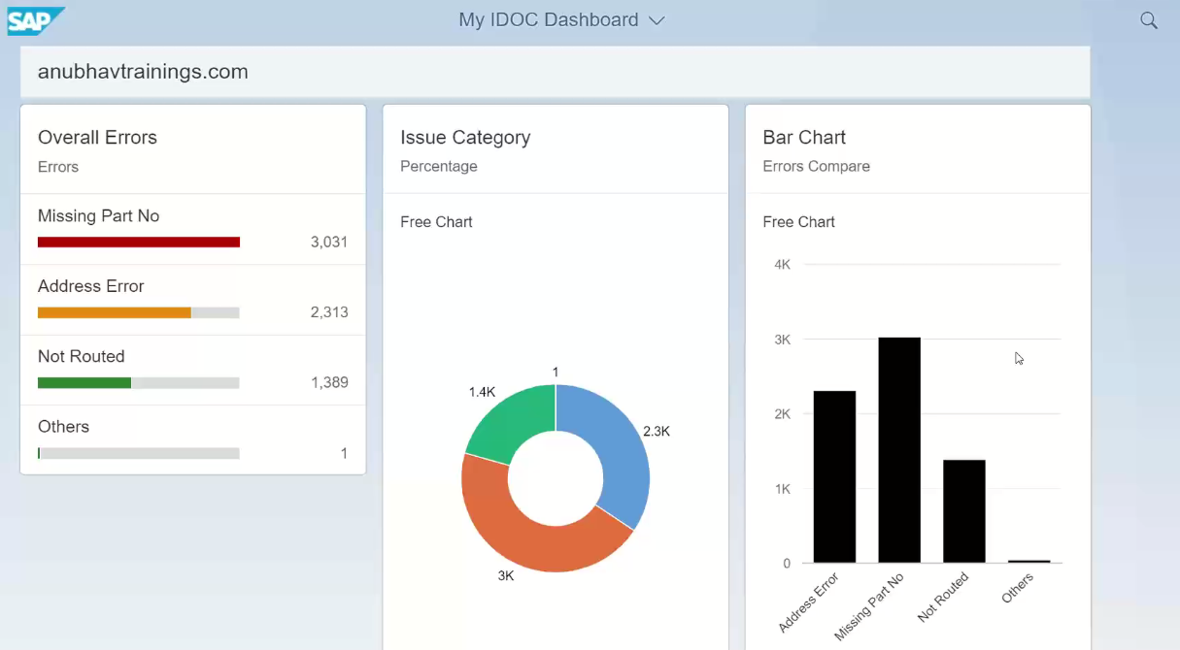
Analytic Dashboard ( OVP )

Slide 22
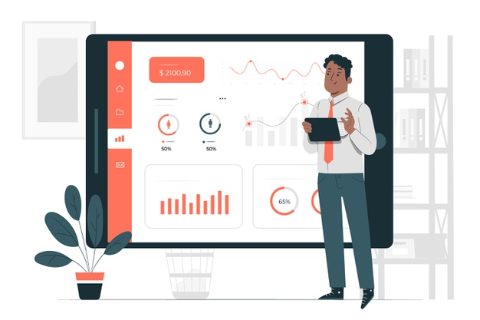
Exercise
End to End S/4 HANA Scenario for Overview Page ( OVP )

Slide 23

End of Day 16

Slide 24

Questions

Slide 25

Anubhav Oberoy

Slide 26


We’re committed to empower you to be
Most Desirable Resource
through powerful training solutions.
We build the workforce of the future.
250+
Corporate Clients
30,000+
Learners Trained
25000+
Learners Placed
FREE WEBINARS
Sign up for free webinars with industry experts every fortnight!
Enroll Now!
Contact us today!
https://anubhavtrainings.com/

Slide 27




More from AnubhavTrainings.com

